Slide 1
11_28

Slide 2
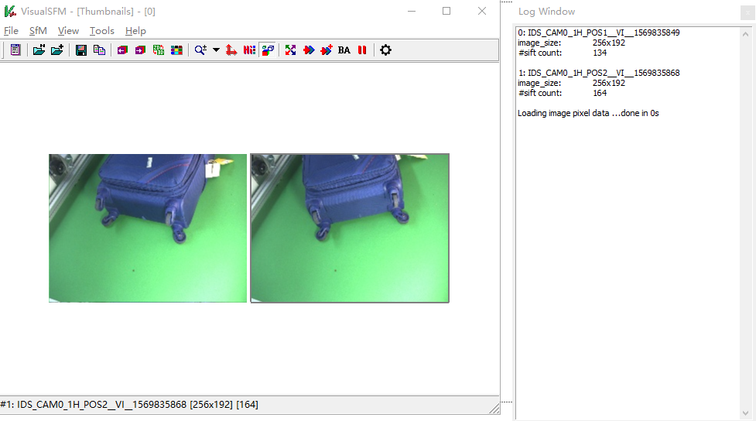
Attempts besides colmap
VisualSFM:
Not works
Failed to match
Run full 3D reconstruction, begin...
0 pairs have two-view models
0 pairs have fundamental matrices

Slide 3
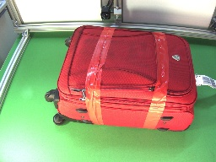
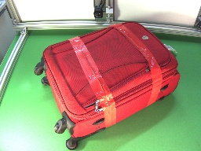
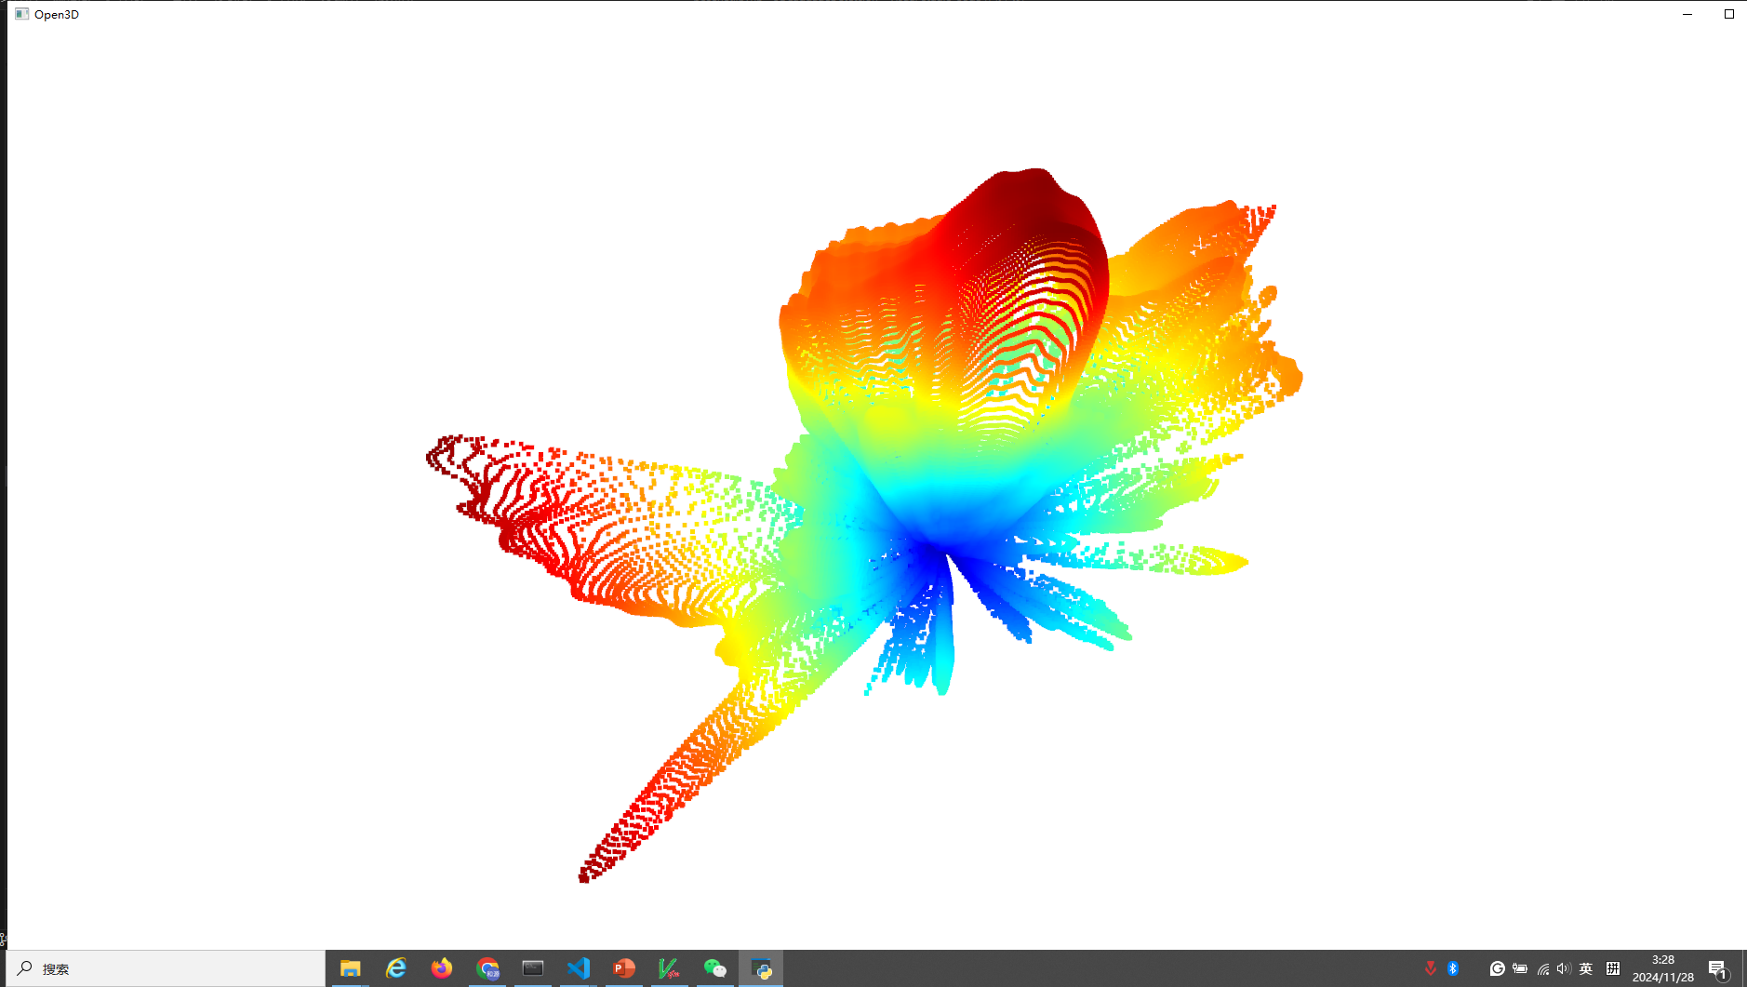
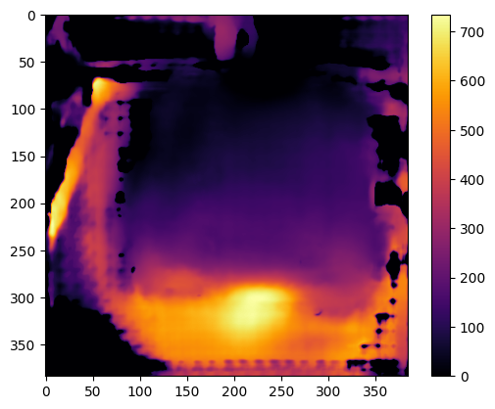
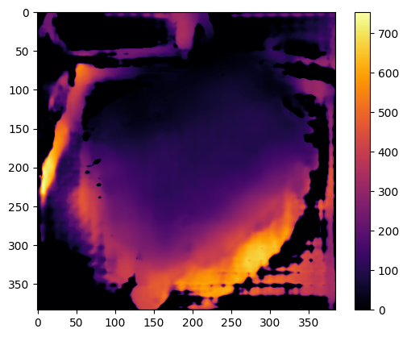
Attempts besides colmap
PoseNet:
Considerable depth map
Unacceptable 3D cloud

Slide 4
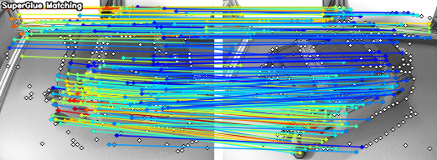
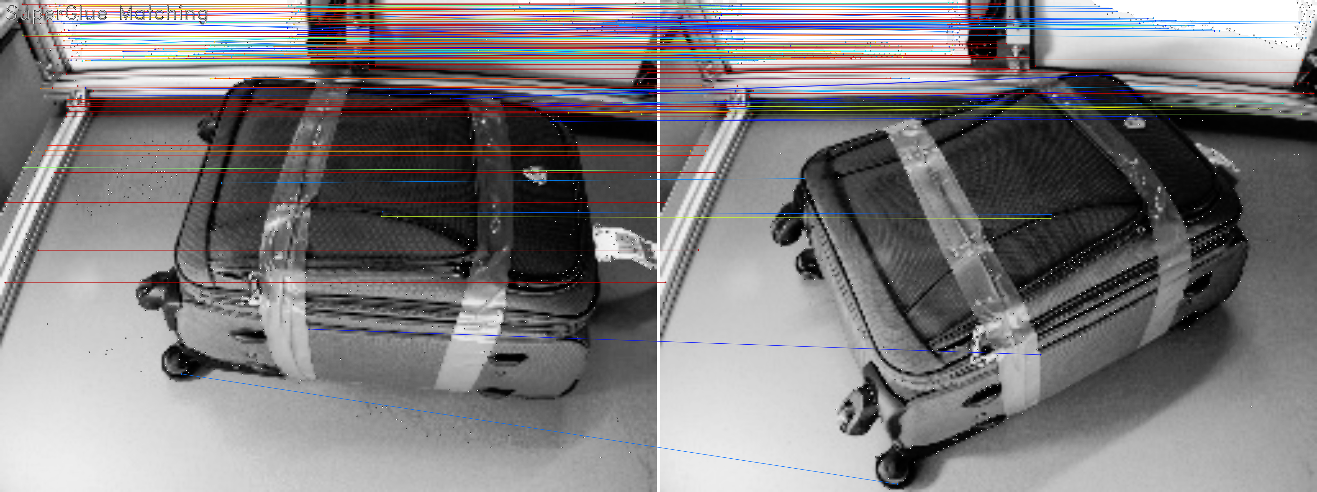
Attempts besides colmap
SuperGlue:
Still have problems on amount of matching points
Modify the parameters -> match unrelated things
High resolution is not work number of matching: 228

Slide 5
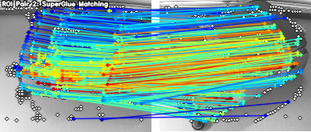
Attempts besides colmap
SuperGlue:
Still have problems on amount of matching points
Modify the parameters -> match unrelated things
Introduce the box estimated by YOLOv11n
Numbers of matching points:
184 -> 267

